Slide 1

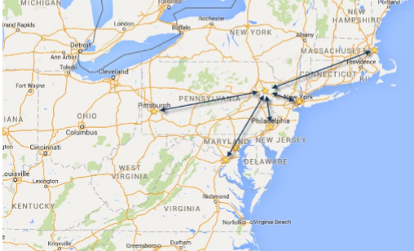

November 7-10, 2023 | Pocono Manor, PA
Great speakers with top content
A fraction of the cost of the more crowded conferences
– 3-day conference plus lodging for less than $1000
Full day deep dive preconference sessions available
Easy to get to from almost anywhere
In addition to the breakout sessions, you get a great hallway
track, attendee reception, game night and more
Full day of kids & family sessions on Friday, free for families of attendees
Discounted Kalahari Waterpark room nights: stay, learn and play all in one place
https://techbash.com or @techbash

